Slide 1
Important Pointers for the Idea Submission
Please ensure below pointers are met while
Kindly keep the maximum slides limit to 4 pages.
All the topics should be utilized for description of your idea
Try to avoid paragraphs and post your idea in points
Keep your explanation precisely and easy to understand
Idea should be unique and novel. If it has a business potential more weightage will be given.
Apart from this PPT abstract of your idea will be asked separately while submitting
You need to save the file in PDF and upload the same on portal. No PPT, Word Doc or any other format will be supported.
You can use own theme for the slides.
You can delete this slide (Important Pointers) when you upload the details of your idea on KAVACH PORTAL.

Slide 2
Basic Details of the Team and Problem Statement
PSID: KVH-009
Problem Statement Title: Advanced CCTV analytics solution
Team Name: YouOnlyWinOnce-v6
Team Leader Name: Kashyap chandra
Institute Code (AISHE):
Institute Name: Indian institute of information technology Kottayam

Slide 3
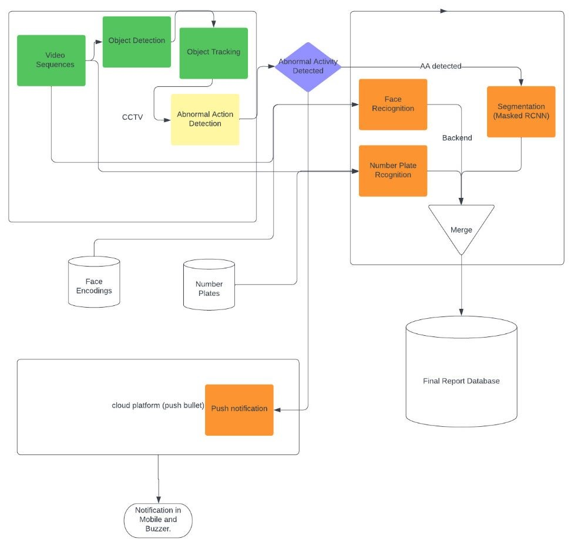
Idea/Approach Details
The proposed idea is a 2- stage verification intelligent surveillance system ie , one on CCTV side and one on server side
First the important objects will be detected like person, vehicles, bags
The detected objects will be tracked (to lower the computation)
An object detection module will detect if abnormal behavior on tracked objects
On server side the a face recognition and a vehicle number plate detection module will be monitoring
In case of any abnormal behavior that point time from the CCTV will be sent to database and on the server side the abnormality will be segmented and create a report with 20sec video along with location and time
Based on the location an alert will be generated on to connected mobile (connected to cloud) and buzzer will be alerted in near by police station
New alerts will be displayed in a simple GUI window and remaining details will be stored in a database
Technology stack:
Raspberry pi
Yolo v-8
Kalman’s filter
Mask RCNN
Face-net
Push bullet

Slide 4
Idea/Approach Details
Use-Cases
Show stopper and dependencies
This project can be used in public mall to detect any robbery
Intelligence department activities related to surveillance.
Detecting criminal activities from surveillance videos.
Crime detection, including identifying if a criminal activity occurred in a recorded video or frame.
Crime detection and classification, which involves extending crime detection to classify the type of crime, such as burglary, shooting, fighting, etc.
The main idea that differ in this project form another models is here we are using custom made object tracking model to minimize the computation in CCTV
We added additional functionalities like face recognition for detecting any unauthorized person and vehicle number plate detection and OCR to detect any filed missing vehicles
We are using two way verification for abnormality
At the frontend we integrate camera module with raspberry pi. The data captured by camera module is processed in raspberry pi using ML lite.
The processed data is sent to cloud using IOT.
Raspberry pi alerts the police by sending a push notification to his/her mobile using push-bullet platform.
There’s also other alerting system where a buzzer is buzzed which is integrated with IOT using raspberry pi at the police side when there is an abnormality is detected.

Slide 5
Team Member Details
Sr. No. | Name of Team Member | Branch (Btech/Mtech/PhD etc): | Stream (ECE, CSE etc): | Year | Position in team (Team Leader, Front end Developer, Back end Developer, Full Stack, Data base management etc.)
1 | Kashyap Chandra | B tech | CSE | III year | Team Leader
2 | Ashutosh Rai | B tech | CSE | III year | Computer vision
3 | Manikanta | B tech | CSE | III year | Computer vision
4 | Abhinav | B tech | ECE | III year | Internet of Thing
5 | Sudheer Reddy | B tech | CSE | III year | Computer vision
6 | Nithisha | B tech | CSE | II year | Back-end developer
Team Mentor/s Details
Sr. No. | Name of Mentor | Category (Academic/Industry): | Expertise (AI/ML/Blockchain etc): | Domain Experience (in Years )
1 | Dr. Bhanu Chander | Academic | AI/ML
2

Slide 6




Thank you

